Slide 1
ONDC Agri Hackthon
Innovation track
Challenge-2

Slide 2
Problem statement
The objective of this challenge is to develop a prototype for fast digitization of catalogs and lifecycle management of the digital catalog.
Define a schema (appropriate for at least 10,000 products) for an online catalog for farm & dairy products, that includes a set of basic attributes including but not limited to the attributes defined below:
● Farm details - farm name, location i.e. GPS coordinates or equivalent;
● Product details - for the purposes of this challenge, a product includes the following attributes - ID, name, pack size, description, price, image, quantity, grading, variants, perishability;
● Logistics criteria - may be defined at a product level and provide options such as - logistics needs, cold chain requirements, ideal delivery turnaround time;
● Payment criteria - may be defined at the store level and includes options such as the following - cash, UPI, Rupay vouchers, Kisan credit card, etc.;
2. Develop an intuitive interface, using text or voice or image input or a combination of these, for digitizing a product that is grown in the farm. The solution should focus on ease of use and
convenience for the farmer. This may work in either of the following ways:
● Take a photo and auto-label or scan machine readable codes (e.g. QR code);
● Add entry through voice to text conversion of voice input;
● Add text entry and supplement with an image;
● Any combination of the above or using any other intuitive mechanism;
3. The intuitive interface developed in (2) above should support:
● Digitisation of at least 100 farm & dairy products in 30 minutes;
● Populate the digitized catalog in the schema defined in (1) above;
● Using any one of the following Indic languages - Hindi, Marathi, Telugu, Kannada;

Slide 3
Solution
The core idea of this solution is:
End sellers like farmers will not be able to create and manage a catalog of products of their own. Secondly, most farmers in a region (like a village, town, district etc…) tend to grow/sell a small number of farm products. Hence the thought is that an aggregator seller app can create a catalogue of products that are union of all products sold by the farmers in the region. The end sellers (farmers) are then only required to name the products they want to sell and the price at which they want to list their products. To simplify the process of getting list prices (and inventory position) from farmers, we propose to have the farmers write product prices on a physical form and use ML/OCR to scan the form and get the price/availability from that form

Slide 4
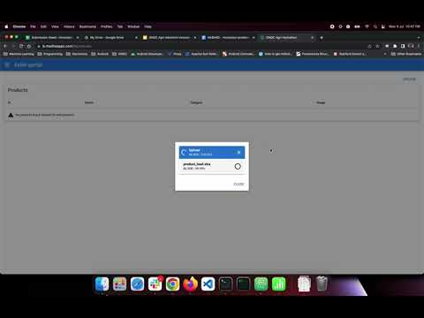
Solution details
Step - 1
Seller aggregator team creates a master catalogue of products using a xls upload. This catalogue includes all products potentially sold by farmers (end sellers) in a region
Video with this step:

Slide 5
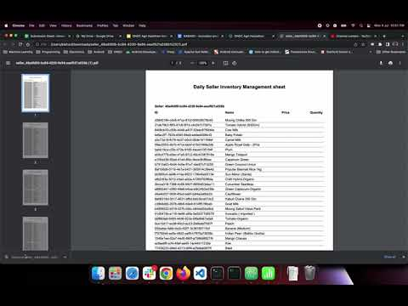
Solution details
Step-2
Seller aggregator sets up the seller (farmer) in the system and generates seller specific data entry form
The idea is that all farmers in that region use the same catalogue, but will have different prices/availability for products and hence will just to enter those details. Since it might be difficult for the farmer to enter the price for dozens of products in an app, we think filling a paper form is easy

Slide 6
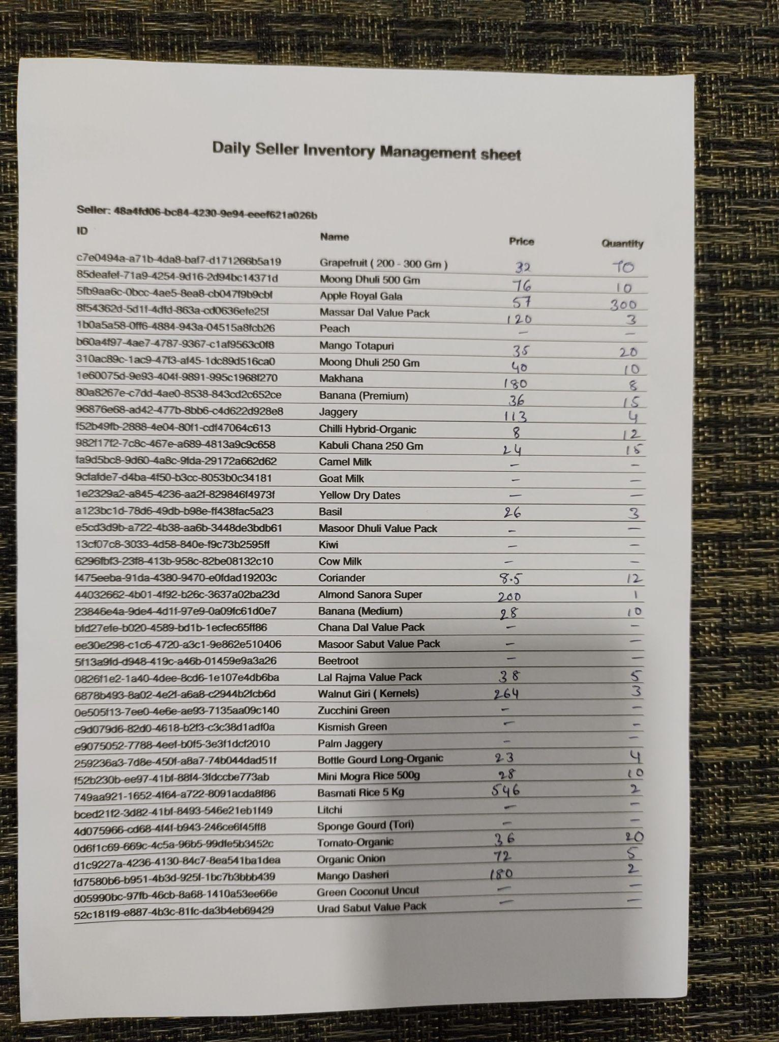

Solution details
Step-3
The famer (end seller) will take a photocopy of the form on a daily basis and fill in the price/availability details. Using a smartphone/camera, the form is photographed and uploaded to the seller app. The seller app will do a handwriting recognition and update the seller (farmer) specific catalog with price and availability.

Slide 7
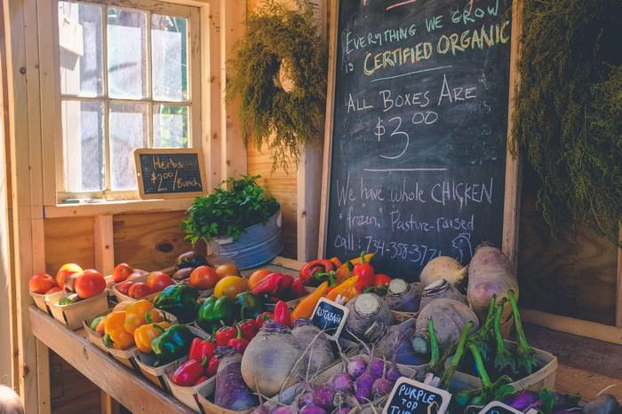
Solution
This solution is not limited to scanning prices from printed forms. If the farmers (end sellers) do not have a printer/photo copier, we can even make this solution work with price/availability of products from a chalkboard based price list we typically see at a mandi. The idea is that handwritten content can be scanned and processed by a backend and avoid need to manual entry by the end seller

